Slide 1
Traffic Sign Detection in Foggy Weather
Aditya Raj AU1920177
Dhruvanshu Parmar AU1940166
Computer Vision (CSE541)
Guided by:
Prof.Mehul Raval
T.A.Vaishwi Patel
T.A.Arpitkumar Patel

Slide 2
Introduction
With the progressing world we are now entering towards the world of autonomous vehicles. And traffic sign detection is the key part of the autonomous vehicle and the efficiency of traffic sign detection is important in all weather conditions. Since we know that during foggy weather condition accuracy of traffic sign detection get reduced drastically. Hence, In this project we are finding ways to increase the accuracy of traffic sign detection.

Slide 3
Problem Statement
In this project we are trying to create a CNN (convolutional neural network) model which can detect traffic sign even in foggy weather condition with less inference time and using low computational resources.

Slide 4
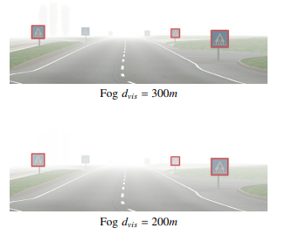

Existing body of work
There is paper( Impact of reduced visibility from fog on traffic sign detection[2]) which explains about the creation of synthetic images of fog from the images without fog.

Slide 5
Existing body of work
Process discussed in paper for creating artificial fog in the image:
Mathematical equation has two parts that is added together to create artificial fog in the image.
In the first part original image with the object distance is calculated
In the second part, grey pixel is calculated based on the object distance
K in the equation is the grey in the image based on the cloud

Slide 6
Approach
We approached the problem in two parts:
Part 1:
Our first step is to discover about convolutional neural networks architecture or pretrained models that is already present in the market. So that we can build our project upon that.
We came across different models like Faster RCNN, MobileNet but our interest is peaked upon EfficientNet because of its compound Scaling.
In EfficientNet, a new scaling method was introduced that uniformly scales all dimensions of depth/width/resolution using a simple yet highly effective compound coefficient. The Compound coefficient known as φ (phi).

Slide 7
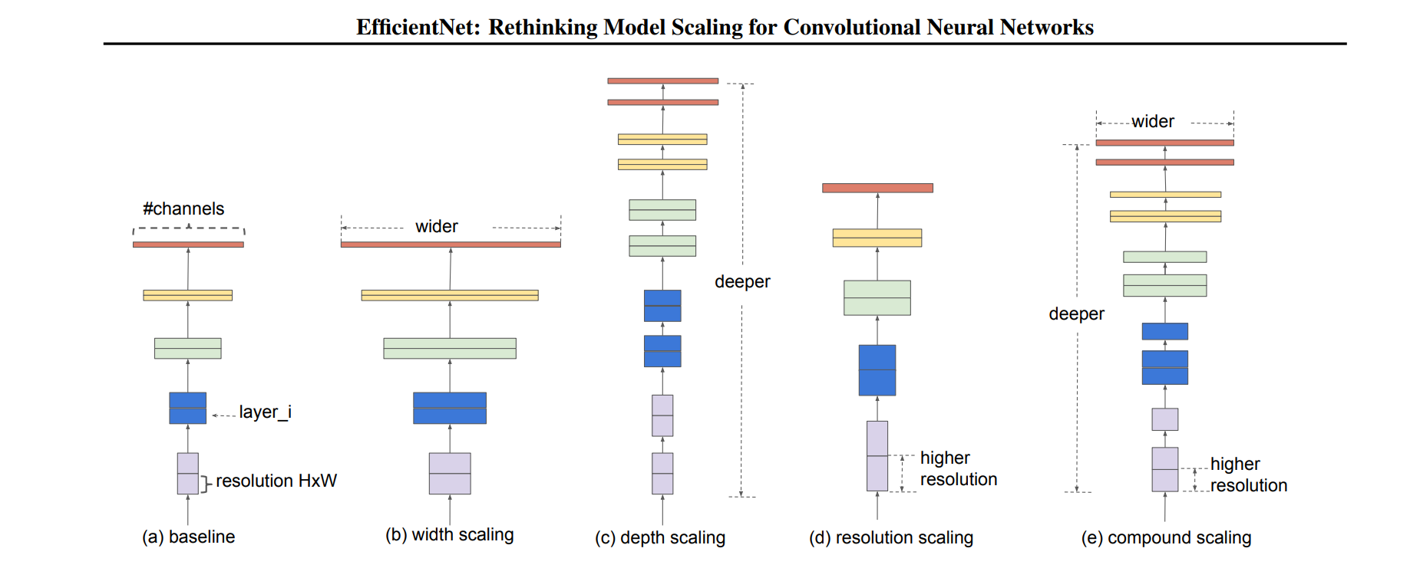
Approach

Slide 8
Approach
Part 2:
The second part is about creating custom dataset for the training.
Our first approach to the problem is to introduce Gaussian blur to the image for the artificial fog creation for the dataset.
The Problem we faced when introducing the Gaussian Blur is that it ruins the boundary of the images.
Then we came across the paper (Impact of reduced visibility from fog on traffic sign detection by Dearborn) there we learned about how to create artificial fog (implementation in progres)

Slide 9
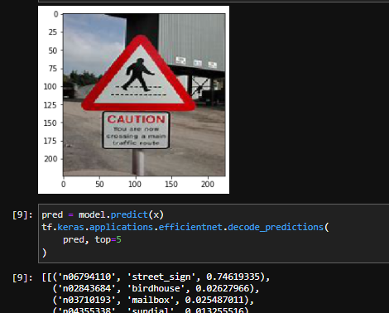
Initial results

Slide 10
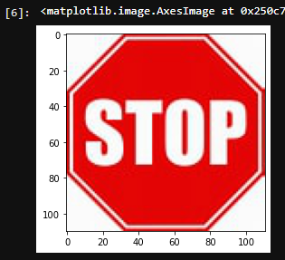
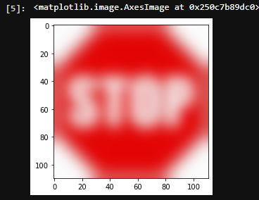
Initial results
Here it is clear that image boundary gets destroyed by using gaussian blur.
After training for 50 epochs in the example code of keras, the accuracy of all the signs are around 40% but the problem here is not accuray instead there is very less detection of traffic signs.
Hence, we come to the conclusion that Gaussian blur alone is not the key for solving the artificial fog problem because of edge smoothing.

Slide 11
Future Work
Working on the Algorithm to create an Artificial Fog to the image using Dearborn’s paper.
Two way to approach the training problem either by transfer learning by keeping the weights of the pre trained model and incorporating only the fog weather condition or start the training from the scratch.
After completing this we might think about solving this problem by using machine learning and the concept of computer vision like HOG descriptor.

Slide 12
References
[1] M. Tan and Q. Le, “Efficientnet: Rethinking model scaling for convolutional neural networks,” in International conference on machine learning PMLR, 2019, pp. 6105–6114.
[2]R. Belaroussi and D. Gruyer, "Impact of reduced visibility from fog on traffic sign detection," 2014 IEEE Intelligent Vehicles Symposium Proceedings, 2014, pp. 1302-1306, doi: 10.1109/IVS.2014.6856535.

Slide 13
THANK YOU

